Slide 1
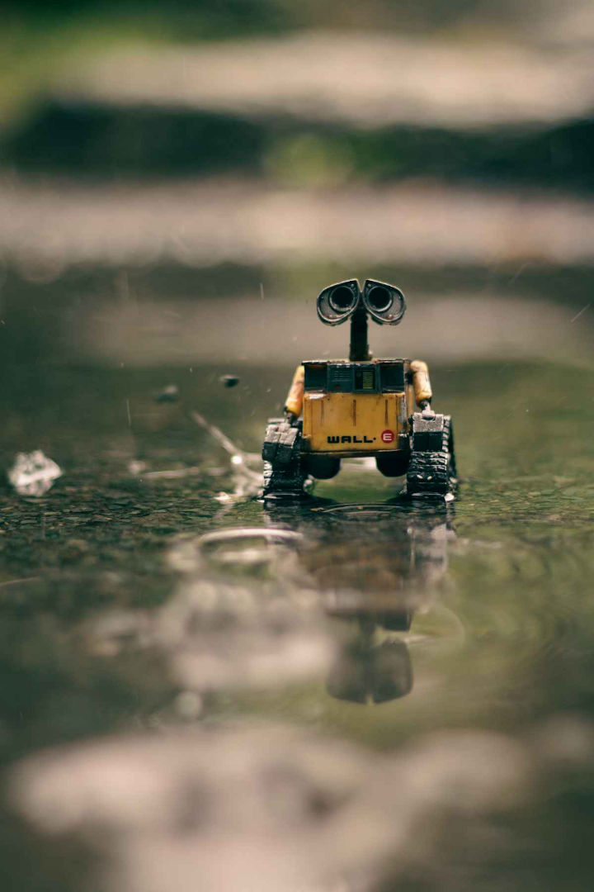

Firefighting Robots in IoT: Revolutionizing Emergency Response
This presentation explores the integration of robotics, sensors, and IoT to create advanced firefighting solutions that enhance safety and efficiency. We will delve into the objectives, existing systems, proposed architectures, key components, design methodologies, results, and future research directions.
Firefighting robots represent a significant leap forward, offering the potential to reduce risks to human firefighters, improve response times, and minimize property damage. The presentation will conclude with a call to action, urging investment and collaboration to accelerate the adoption of this transformative technology.

Slide 2
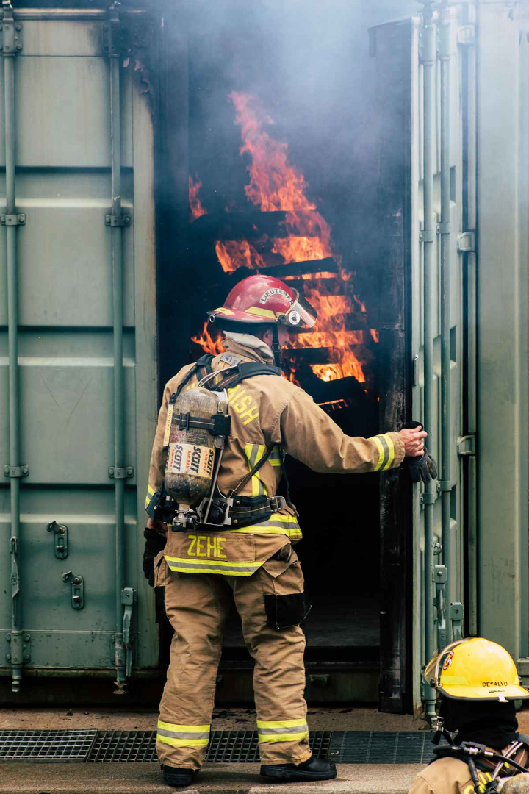
Objectives: Enhancing Safety and Efficiency in Firefighting
Enhance Safety
Reduce firefighter casualties in hazardous environments through remote operation and advanced sensing.
Improve Response
Increase response time and efficiency in fire detection and suppression using real-time data.
Leverage IoT
Utilize IoT flame sensors for real-time data collection and analysis of environmental conditions.
Autonomous Navigation
Develop autonomous navigation capabilities to navigate complex and dangerous environments
Our objectives are to improve existing emergency response through technology, reducing risk to human life, and lowering operational cost over time.

Slide 3
Existing Systems: Limitations and Challenges
High Risk
Limited Visibility
Slow Response
Current firefighting methods expose human firefighters to significant risks, with injury rates around 20%.
Smoke-filled environments severely restrict visibility, hindering effective assessment and navigation.
Manual operations and dependence on infrastructure contribute to slower response times.
Traditional firefighting faces limitations in dangerous environments, leading to higher risks and slower interventions. The 2019 Notre Dame fire showed delayed response and over $1B in damage. These failures highlight the need for improved access and situational awareness.

Slide 4





Proposed System: IoT-Enabled Firefighting Robot (FFR)
Sensor Network
Real-time data collection (temperature, smoke, gas levels).
Autonomous Navigation
LiDAR and computer vision for 360° view.
Remote Control
Interface for human oversight.
Water/Foam Dispensing
Adjustable flow rates (up to 500 gallons/minute).
Our proposed system offers enhanced situational awareness, faster response times, and precision firefighting, minimizing collateral damage and improving firefighter safety. It uses 5G communication, remote operation, and sensor networks to address current firefighting limitations.

Slide 5
Components: Hardware and Software Integration
Hardware
Software
Robot chassis: Heat-resistant materials (up to 500°F)
Navigation algorithms: SLAM, path planning
Thermal cameras (±2°F accuracy)
Sensor fusion: Kalman filtering, data analytics
Smoke detectors (0.01%/ft obscuration)
Communication protocols: MQTT, CoAP
Gas sensors (±5 ppm accuracy)
Control interface: Web-based, mobile app
LiDAR (100 meters range, ±2 cm accuracy)
The robot chassis provides durability in extreme conditions. High-accuracy sensors and 5G communication enable comprehensive data analysis. Sophisticated software algorithms and user-friendly interfaces facilitate remote operation and control.

Slide 6
Design Methodology: System Operation Flowchart
Sensor Data
1
Acquisition of environmental data
Data Processing
2
Fusion and calibration of sensor data
Decision Making
3
Fire localization and suppression strategies
The design methodology involves sensor data acquisition, processing, and decision-making. Actuation controls navigation and suppression, while communication ensures central command. This system employs feedback loops for adaptive control and optimization, making it responsive to environmental changes.

Slide 7
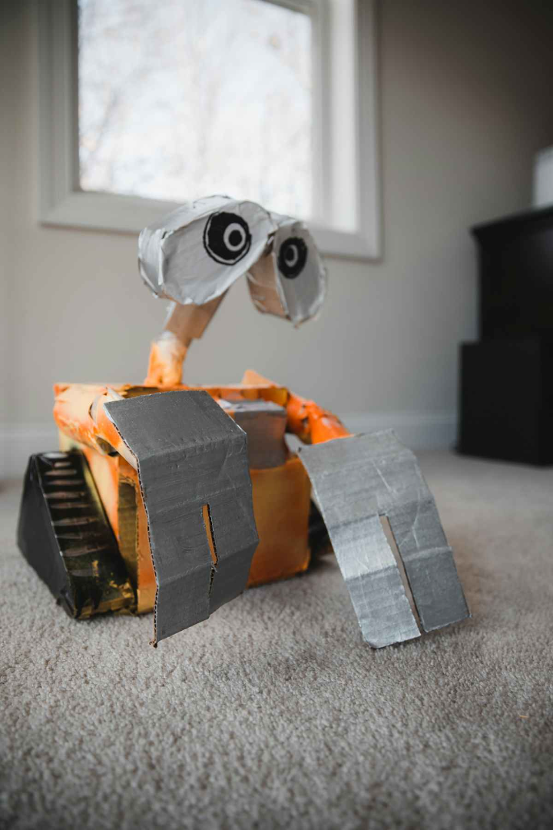



Results: Improved Response Times and Damage Reduction
Faster Response
Reduced Damage
Autonomous Navigation
40% faster response time compared to traditional methods in urban simulations.
30% reduction in property damage due to precision firefighting in warehouse fires.
95% success rate in obstacle avoidance in indoor environments.
Simulations and experiments confirm the effectiveness of autonomous navigation and sensor accuracy, showing a 40% reduction in response time and a 30% reduction in damages. These results highlight the superiority of the system compared to traditional firefighting techniques.

Slide 8
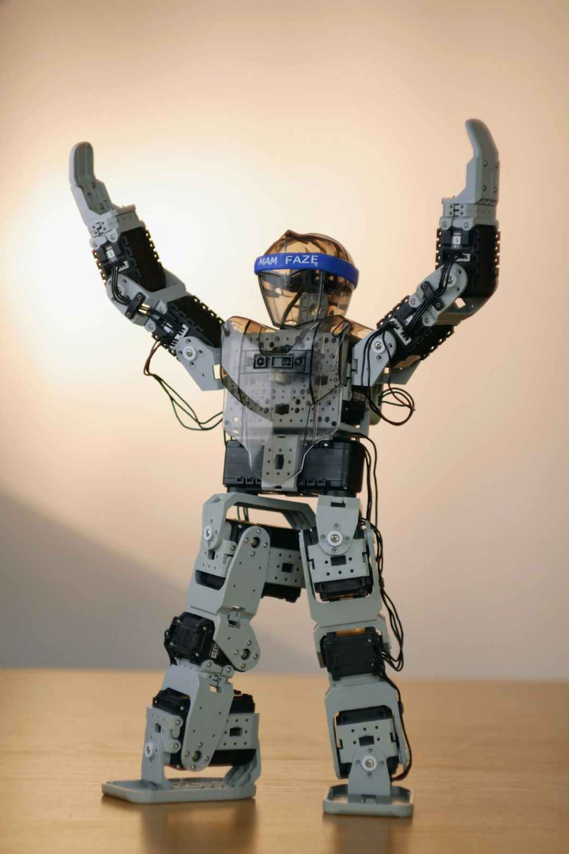
Conclusion: The Future of Firefighting with IoT and Robotics
Future Research
Integration
Improve AI for enhanced autonomy.
Integrate drone technology for surveillance.
Development
Develop advanced heat-resistant materials.
Firefighting robots offer a promising solution, enhancing emergency response and firefighter safety. Future research will focus on improved AI, drone integration, and advanced materials. Investment and collaboration are essential to accelerate the adoption of this technology, promoting innovation and standardization for a safer future.

Slide 9
THANK YOU

